Slide 1
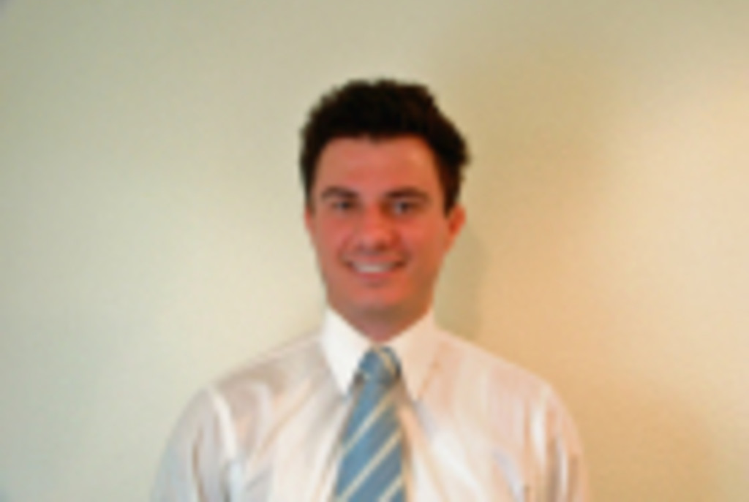
Accenture Team Member Profile
Role:
Profile Overview
Relevant Experience
Clara.com: Salesforce Developer
Planned, designed and developed Lightning Components, Apex triggers, Apex class, JavaScript buttons and API integrations with proprietary systems.
Implemented TalkDesk (CTI app), Marketo, Yelp, PhoneBurner, FastCall, Five9, LiveText, Slack and SendGrid.
Developed custom integration between SFDC, LendingTree and Clara stack.
CRM Systems: Salesforce Developer
Responsible for all phases of SFDC support and development, including business analysis, requirements development, implementation and support of custom processes and apps.
Development of workflows, approval processes, formulas, custom fields and objects, custom apps, custom reports and dashboards, ETL tools, data migration, Apex classes, Apex triggers, Visualforce pages and Web Services.
Analyzed and integrated CPQ and CLM solutions (Steelbrick, Apttus, Oracle CPQ Cloud and Vlocity).
Collaborated with sales team, IT systems leadership, C-Suite and other executives to ensure SFDC functionality meets the needs of internal and external customers. Champion SFDC by educating and mentoring managers on capabilities and SFDC ecosystem applications.
Created supporting technical documentation and detailed design specifications.
Vuk Dukic
Vuk is a Salesforce Developer within Accenture Technology group.
Vuk has experience developing with Apex, Visualforce, Lightning.js and other web development frameworks and technologies.
Vuk has a Bachelor of Science degree from Midwestern State University.
Relevant Skills
Apex
Lightning.js
Web Services
Visualforce
Sales Cloud
Project Management

